Slide 1
Requirement Specification Tool
Software Systems Development
Group - 12

Slide 2
Team Overview
Vaibhav Saxena -
2022202026
Piyush Rana -
2022202012
Ardhendu Banerjee - 2022201005
Priyank Mahour -
2022201047

Slide 3
Introduction - Idea
For VR Products, they have a strong requirement and specification engineering.
There are very few tools and methods practiced for requirement engineering are not capable enough of addressing all aspects of VR product development.
Here we attempt to develop a tool which can do the requirement specification check and validate properties data.

Slide 4






Technology Stack

Slide 5
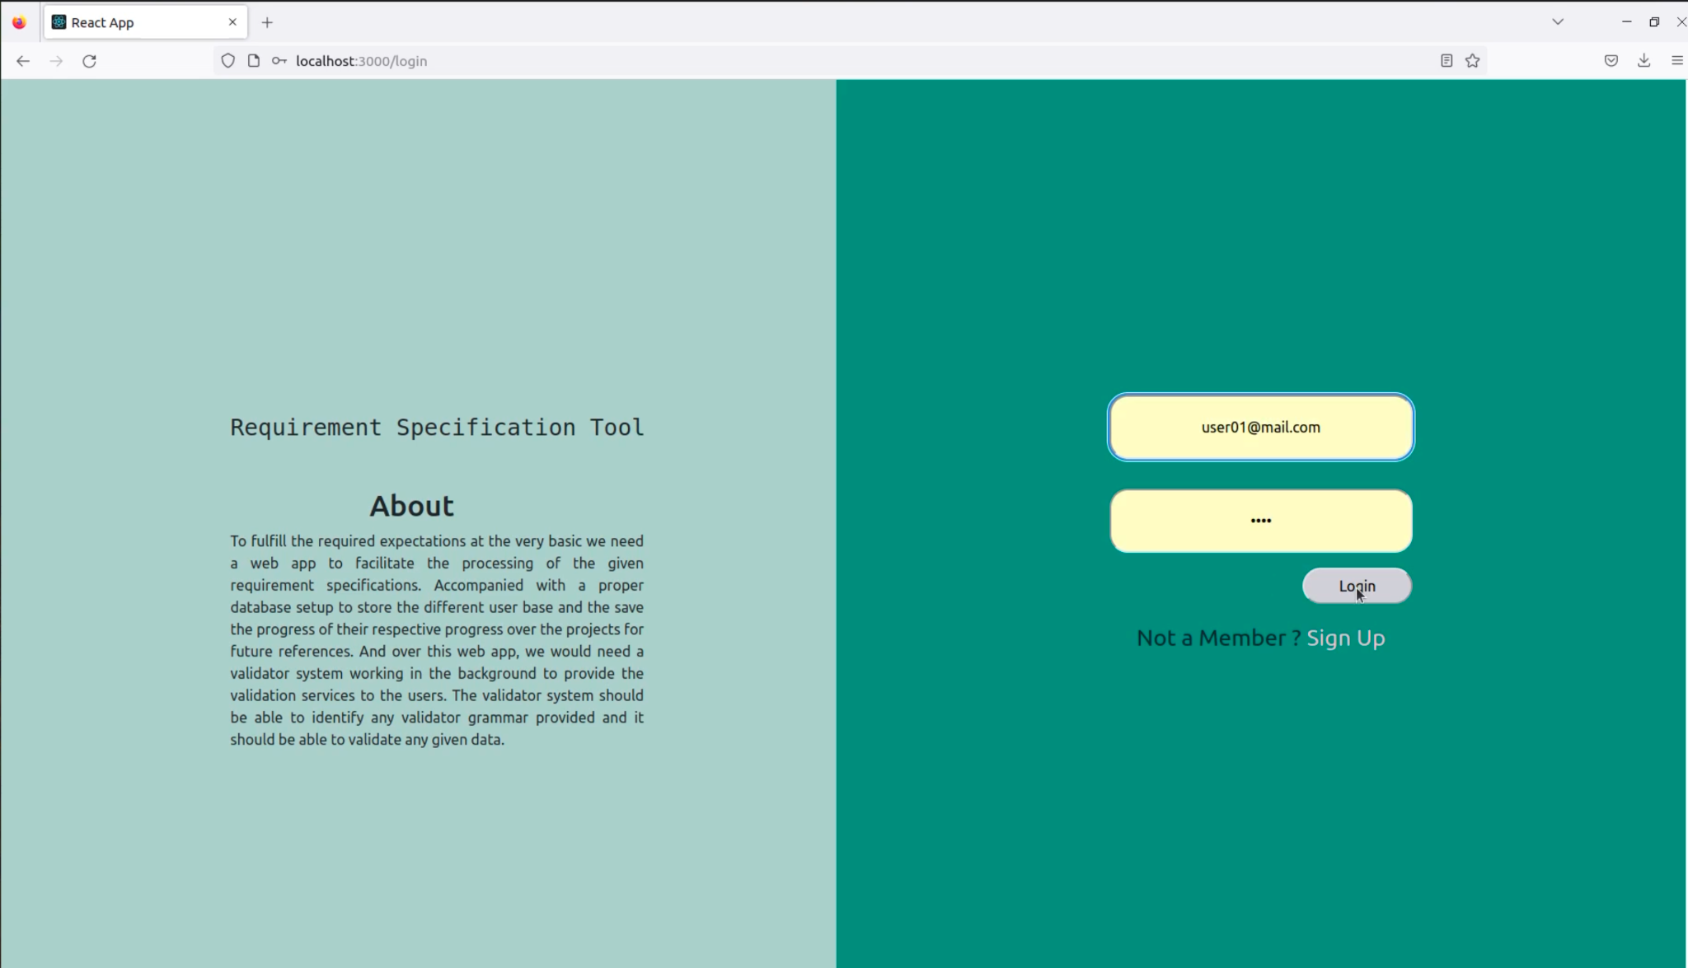
App Structure
Segment 1 - Login Portal
Login Portal lets user login with existing credentials
From the login Page we can be routed to Signup Page for creating new Credentials

Slide 6
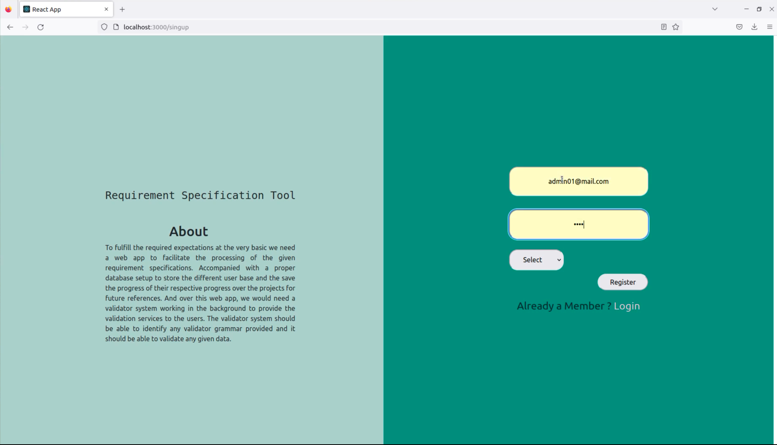
App Structure
Segment 2 - Signup
If the user is not having login credentials, from the login page they will be routed to the Signup Page
Unique email should be used to signup in the portal.

Slide 7
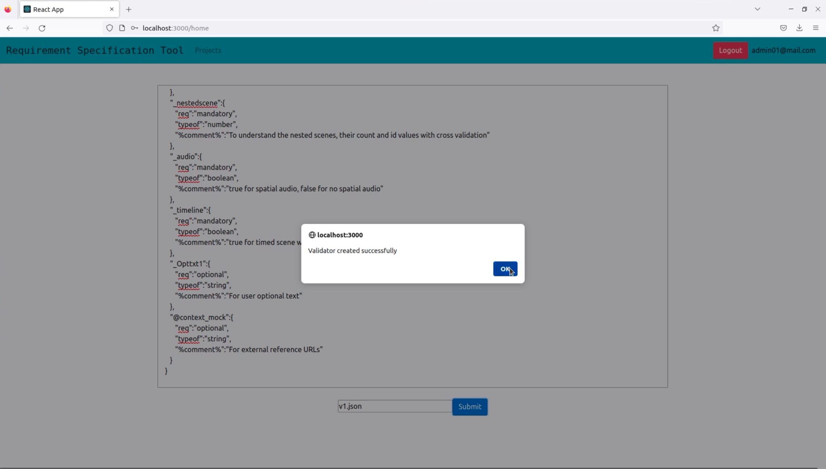
App Structure
Segment 3 - Admin
The login is based on role, Admin and User.
Logging in with Admin role lands on the admin page with facilitates the admin to upload validators in the system

Slide 8
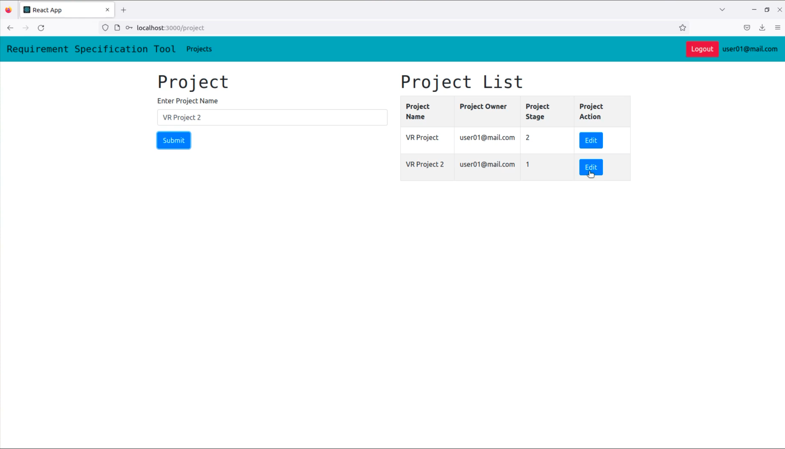
App Structure
Segment 4 - Project Management
Logging in the user lands on the Project management page. Which allows the user to view and edit existing projects. Or new projects can be created from the same page

Slide 9
App Structure
Segment 5 - Requirement Validations
This part is divided into 5 stages.
Stages 1 -> 3 are lets the user validate a specification properties by writing the JSON data in a text area and the validator is to be selected against the validators available in the system that are uploaded by the admins.
Any validation error is displayed in the page with line numbers.
If the JSON is successfully validated a success message is displayed.
All progress in any stage is saved against the session.

Slide 10
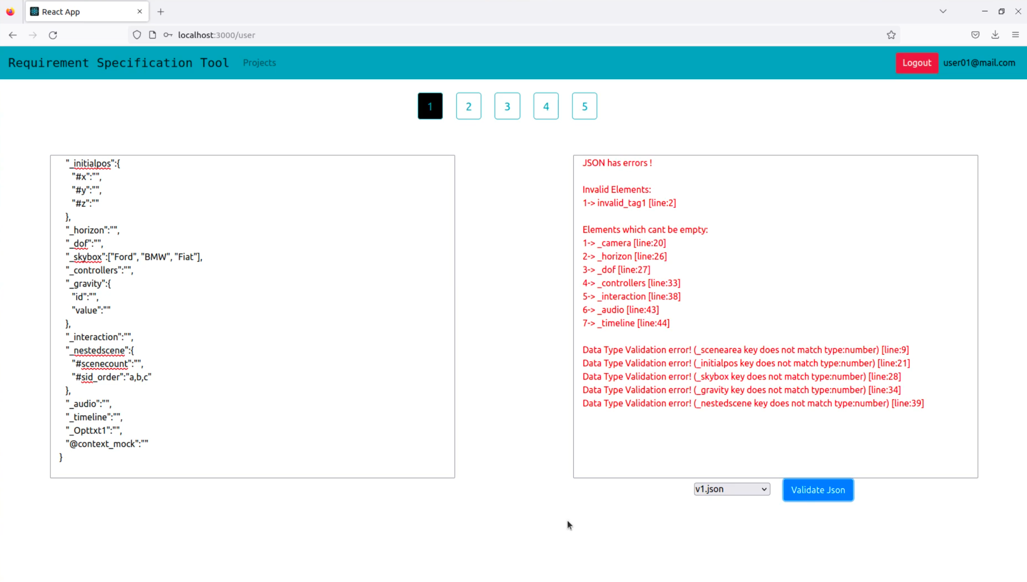
App Structure
Segment 5 - Requirement Validations
We can navigate between all stages of the project.
Stages 1->3 are for the requirement properties validation against validators.

Slide 11
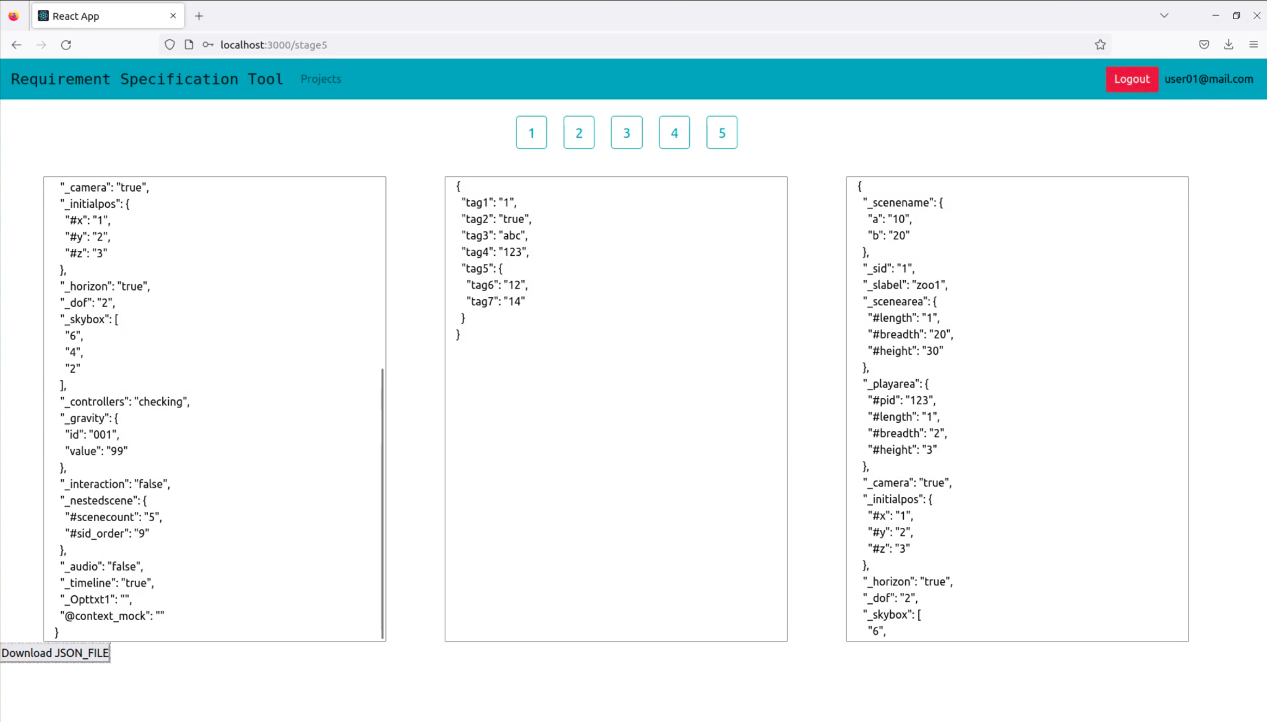
App Structure
Segment 5 - Requirement Validations
Stage 5 lets us see the overall specifications that has been processed through the first 3 stages and provides a download link to download the complete project as a Json file.

Slide 12
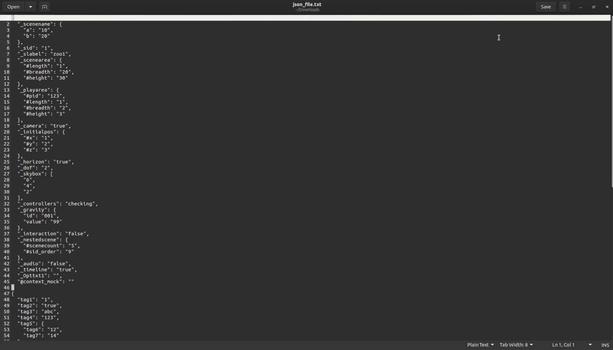
App Structure
Segment 5 - Generated JSON File
Stage 5 lets us see the overall specifications that has been processed through a consolidated JSON File

Slide 13
Thank You

